Slide 1


Gössnitzkees (Schober Group, Hohe Tauern) –
A heavily debris-covered glacier in the context of climate change
Oral presentation
Viktor Kaufmann
Institute of Geodesy
Working Group Remote Sensing and Photogrammetry
Graz University of Technology
Steyrergasse 30, 8010 Graz
e-mail: viktor.kaufmann@tugraz.at
https://www.staff.tugraz.at/viktor.kaufmann/
Andreas Kellerer-Pirklbauer
Department of Geography and Regional Science
Research Group Cascade
University of Graz
Heinrichstraße 36, 8010 Graz
e-mail: andreas.kellerer@uni-graz.at
https://geographie.uni-graz.at/

Slide 2
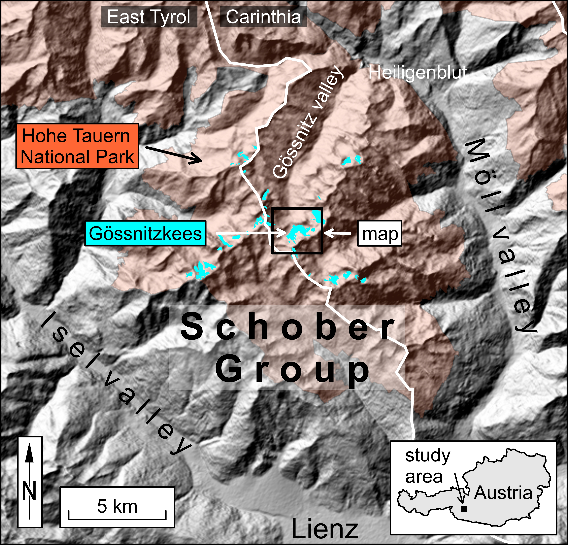
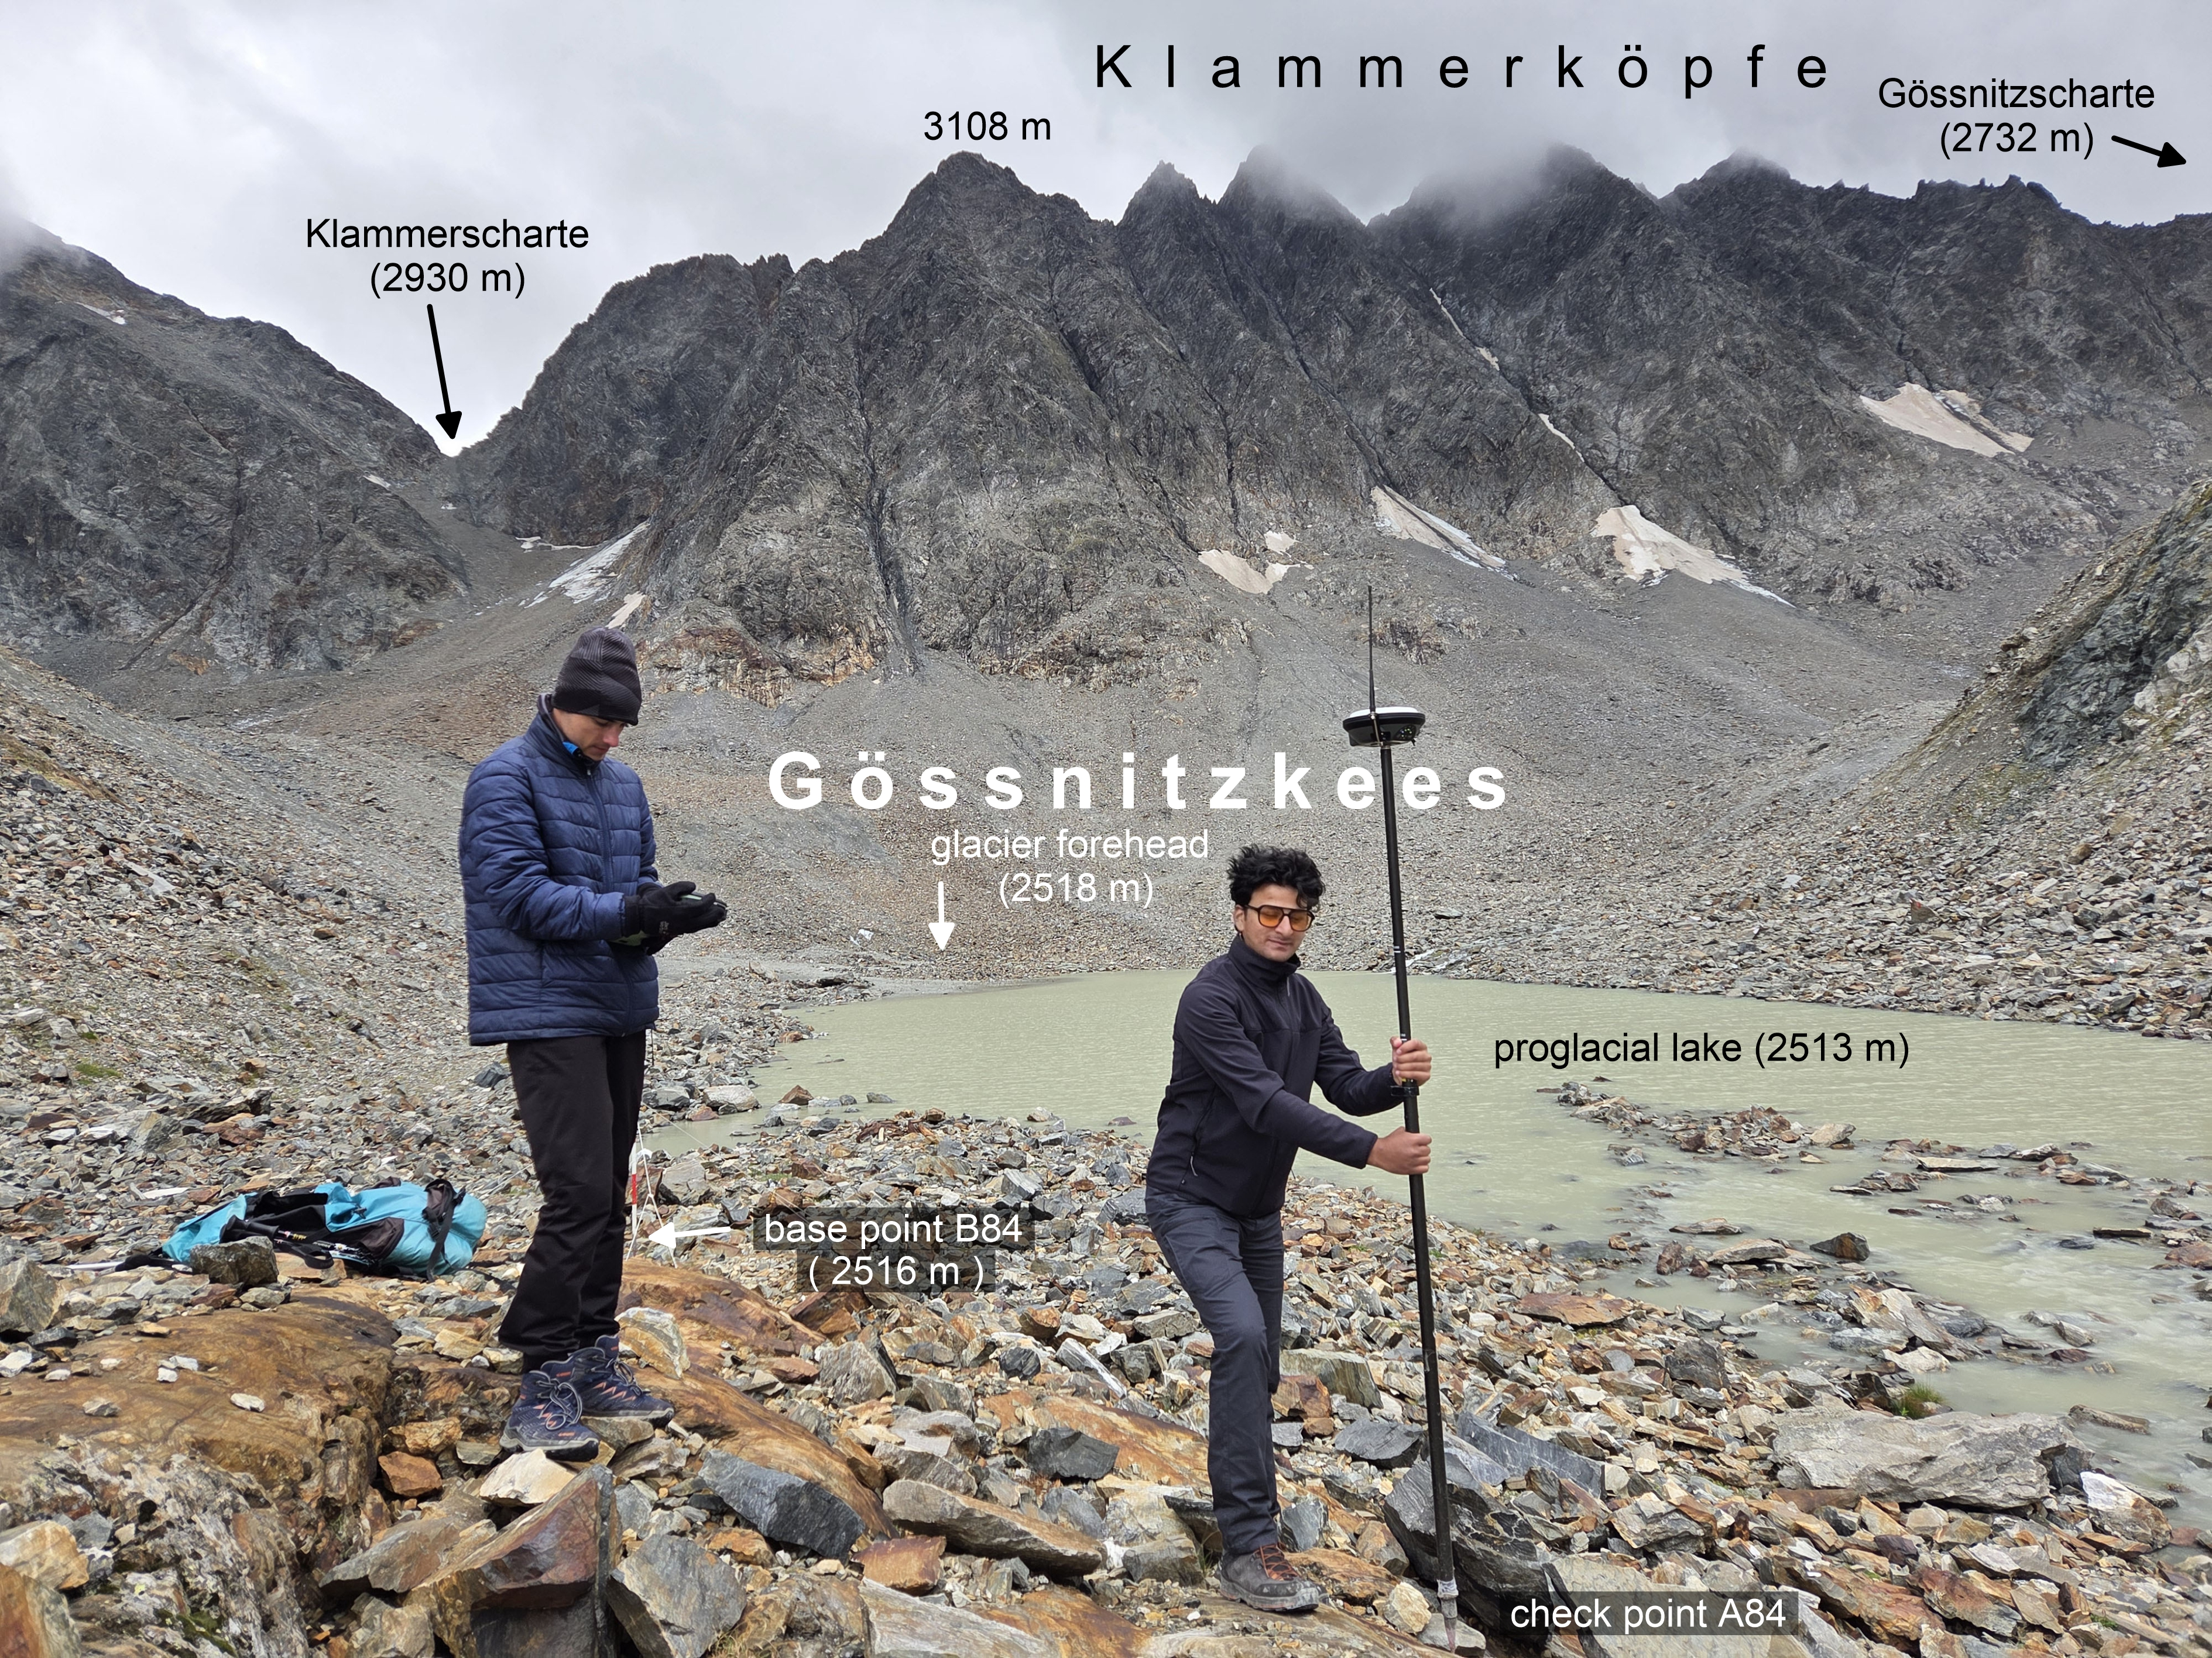
1 Introduction and Motivation
Location of the study area
Geodetic survey, August 29, 2025

Slide 3
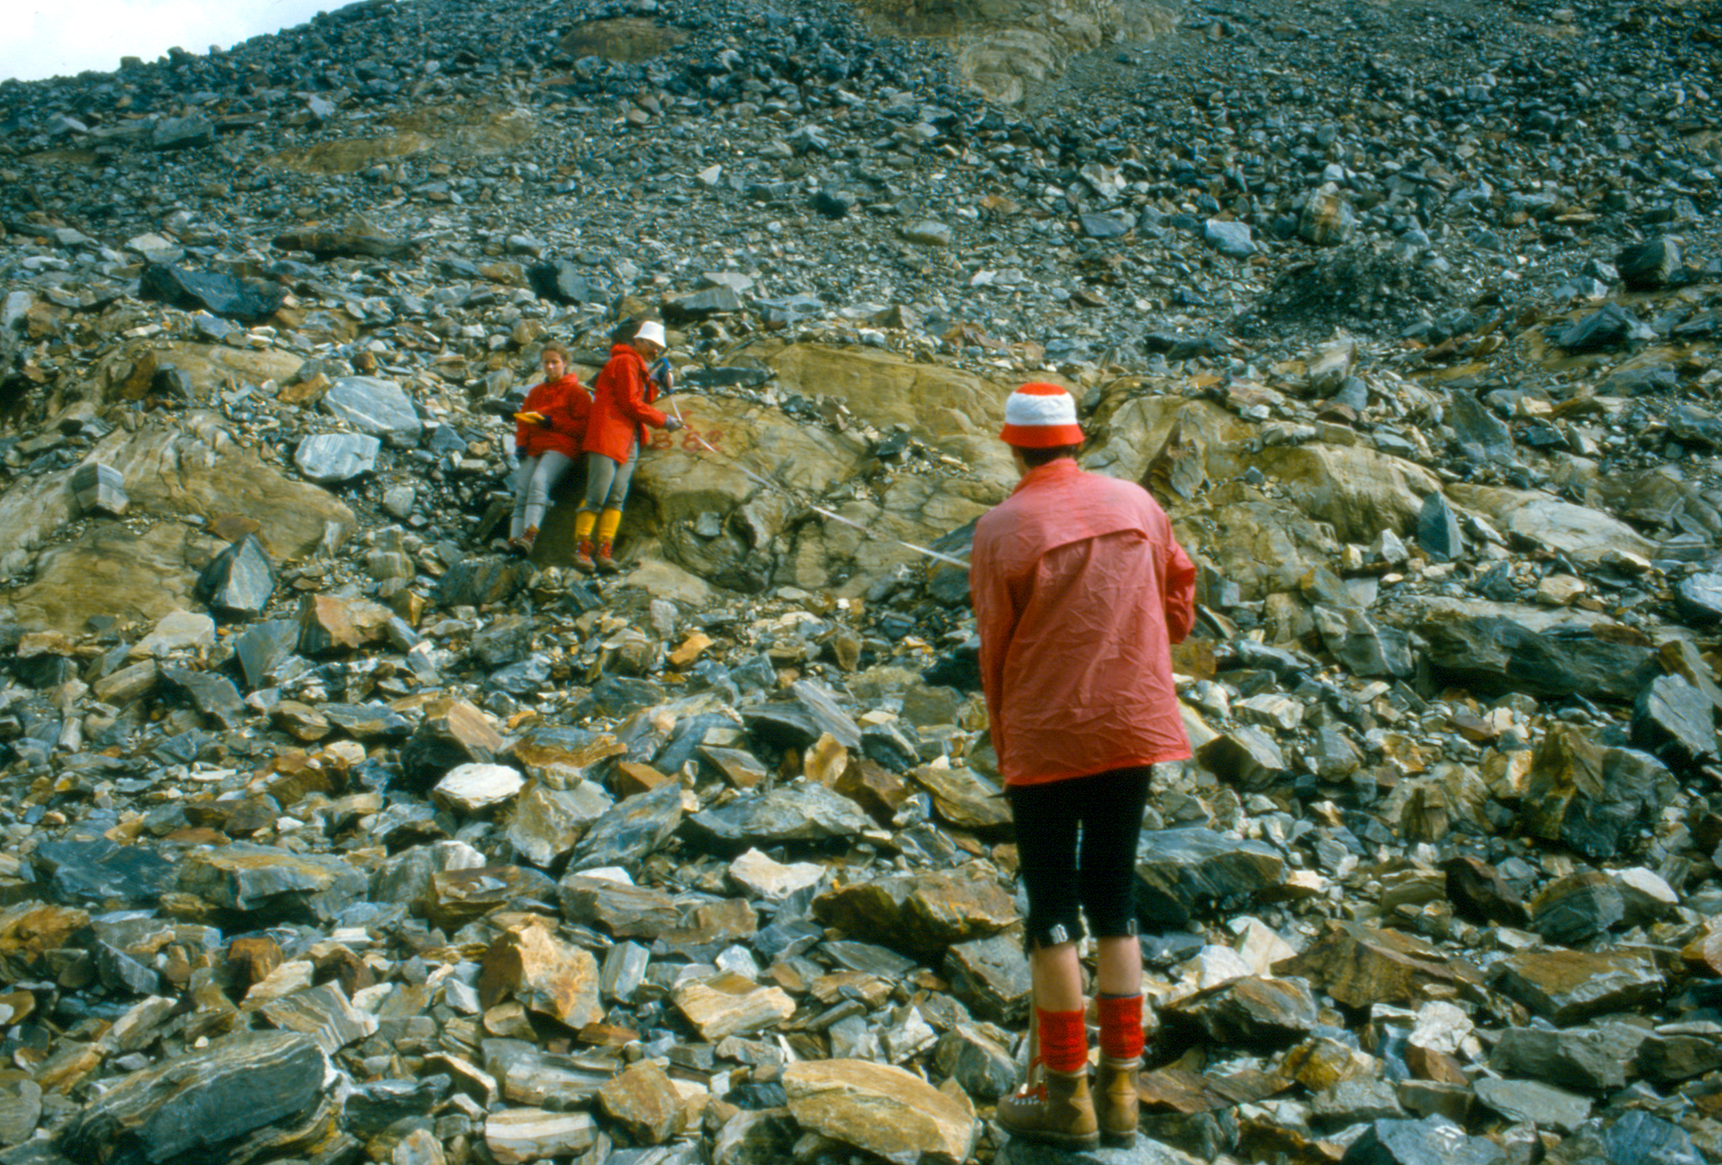
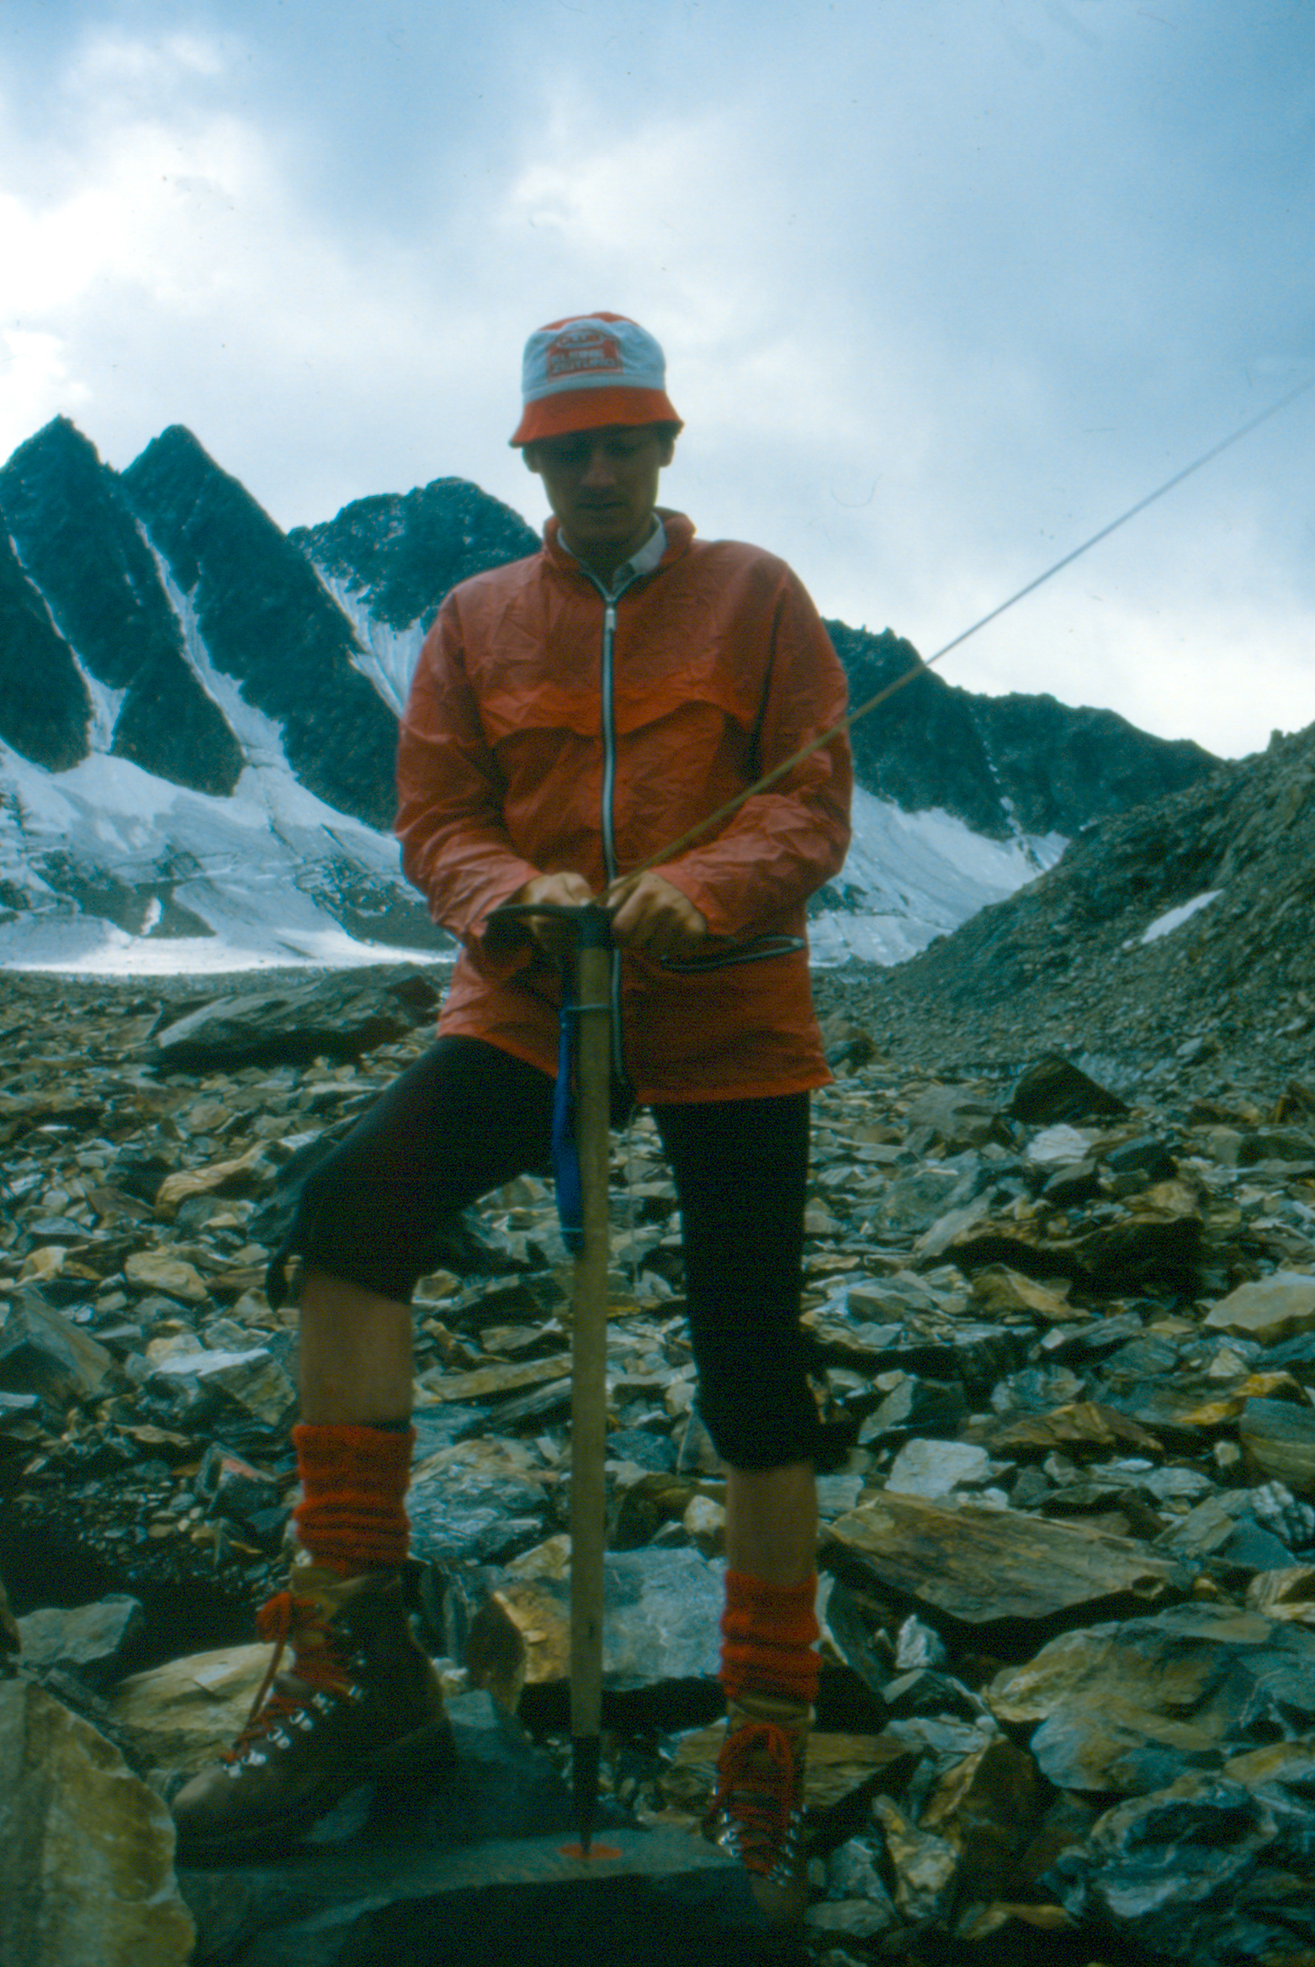
1 Introduction and Motivation
Viktor
First geodetic survey, September 15,1982 (photos from September 7, 1983)

Slide 4
2 Method
2.1 Aerial Photogrammetry
2.1.1 Data Basis
2.1.2 Surface Models and Orthophotos
2.1.3 Glacier Areas
2.1.4 Area and Volume Change
2.1.5 Flow Velocity
2.2 Geodetic Measurements
2.2.1 Ice Thickness Change
2.2.2 Surface Movement
3.3 Climate Monitoring

Slide 5
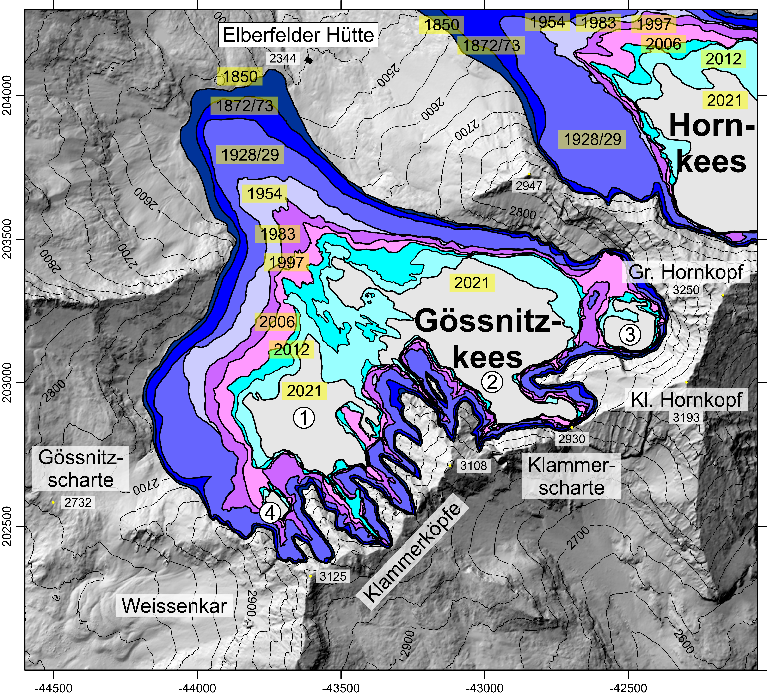
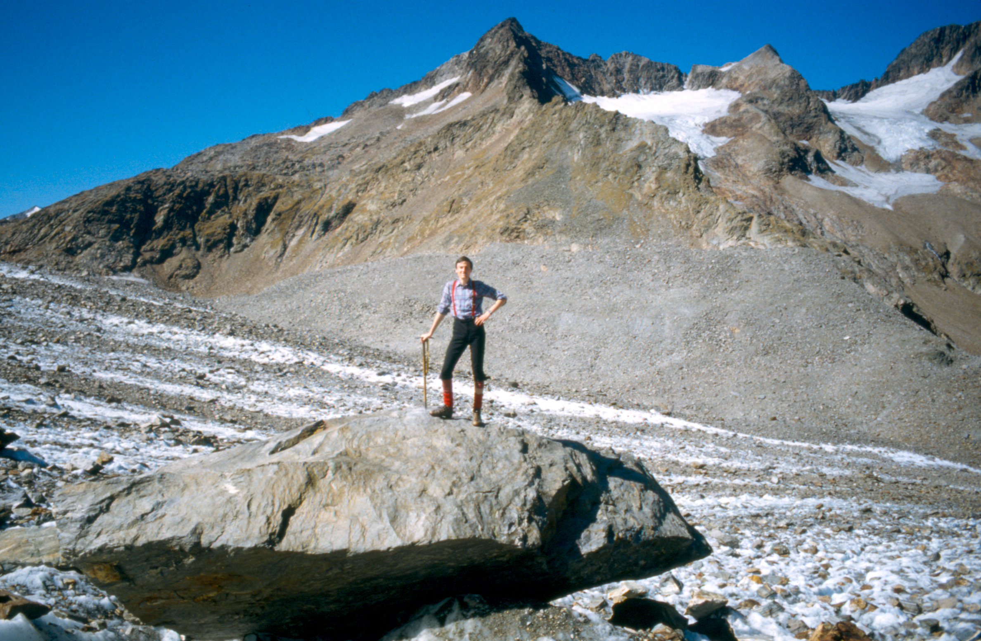
3 Results
3.1 Glacier change based on aerial photographs
Epoch | Area (km²) | Change in area (%) in respect to 1850 | Change in volume (Mill. m³) compared to the previous epoch | Change in ice thickness (cm/year) compared to the previous epoch
1850 | 1.555
2012 | 0.529 | -66.0 | -89.046 | -50
2015 | 0.471 | -69.7 | -0.768 | -52
2018 | 0.399 | -74.3 | -1.414 | -105
2021 | 0.364 | -76.6 | -0.465 | -40
Area, change in area and volume, change in ice thickness
for selected years since 1850.
1850
1850
Glacier table/ gletschertisch at Gössnitzkees,
September 15, 1982.
Map of the Gössnitzkees showing the different glacial stages between 1850 (last maximum, LIA) and 2021.

Slide 6
3 Results
3.1 Glacier change based on aerial photographs
Map of ice thickness change at Gössnitzkees between 2015 and 2021.

Slide 7
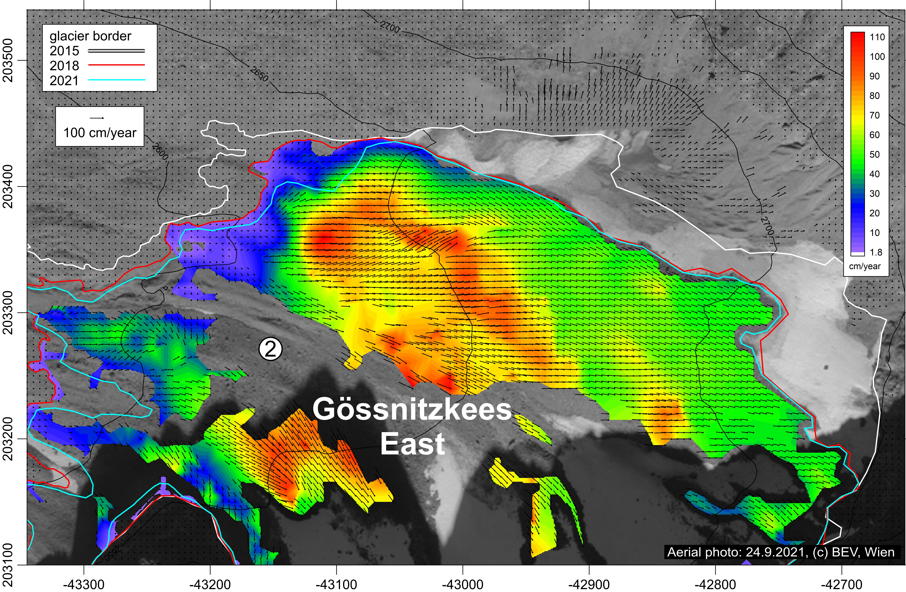
3 Results
3.1 Glacier change based on aerial photographs
Map of the surface movement 2018-2021 in the eastern part of the Gössnitzkees.

Slide 8
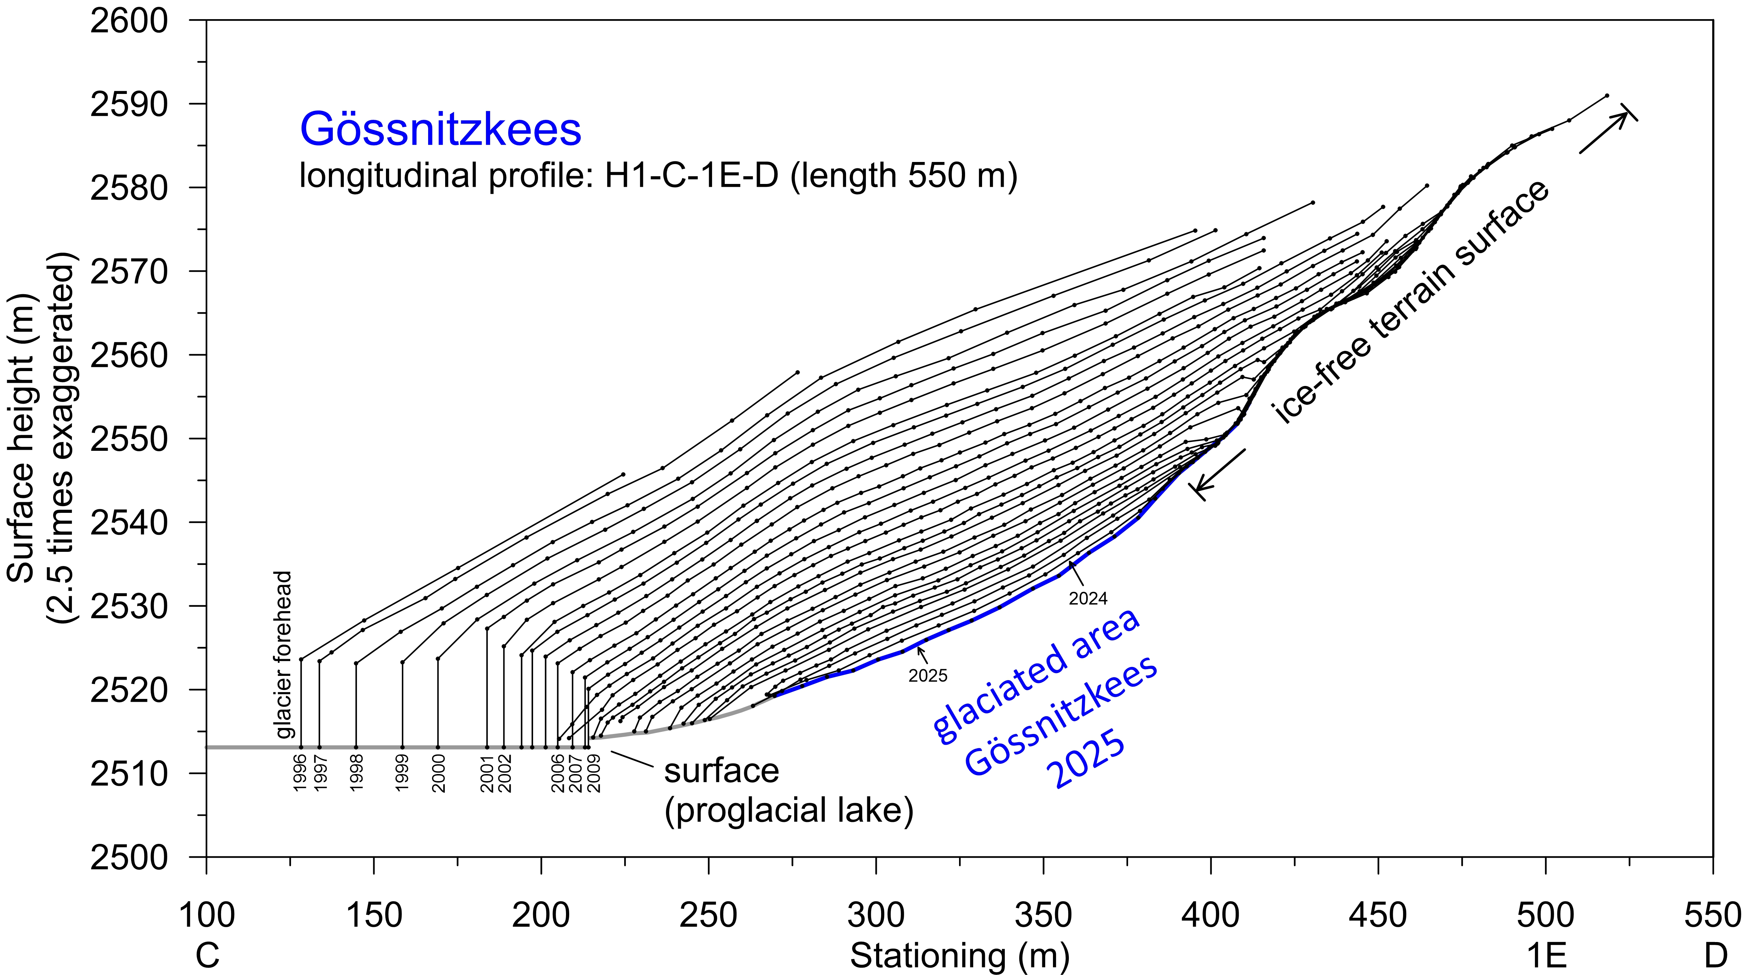
3 Results
3.2 Glacier change based on geodetic measurements
Ice thickness change 1996-2025 in the longitudinal profile.

Slide 9
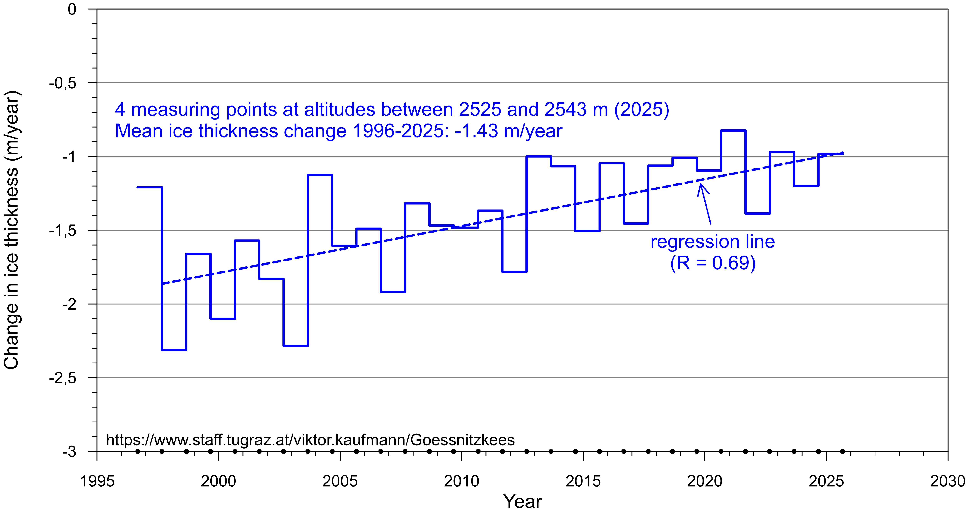
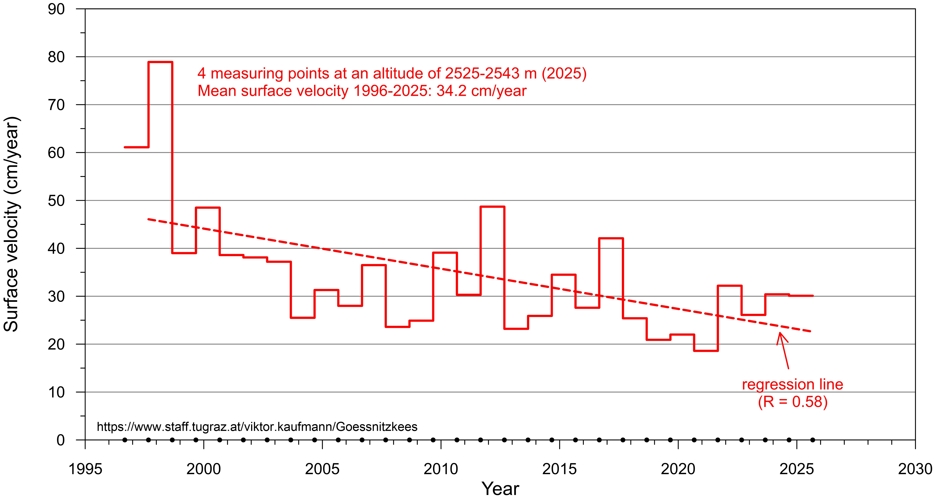
3 Results
3.2 Glacier change based on geodetic measurements
Mean ice thickness change 1996-2025 at 4 marked points.
Mean surface velocity 1996-2025 at 4 marked points.

Slide 10
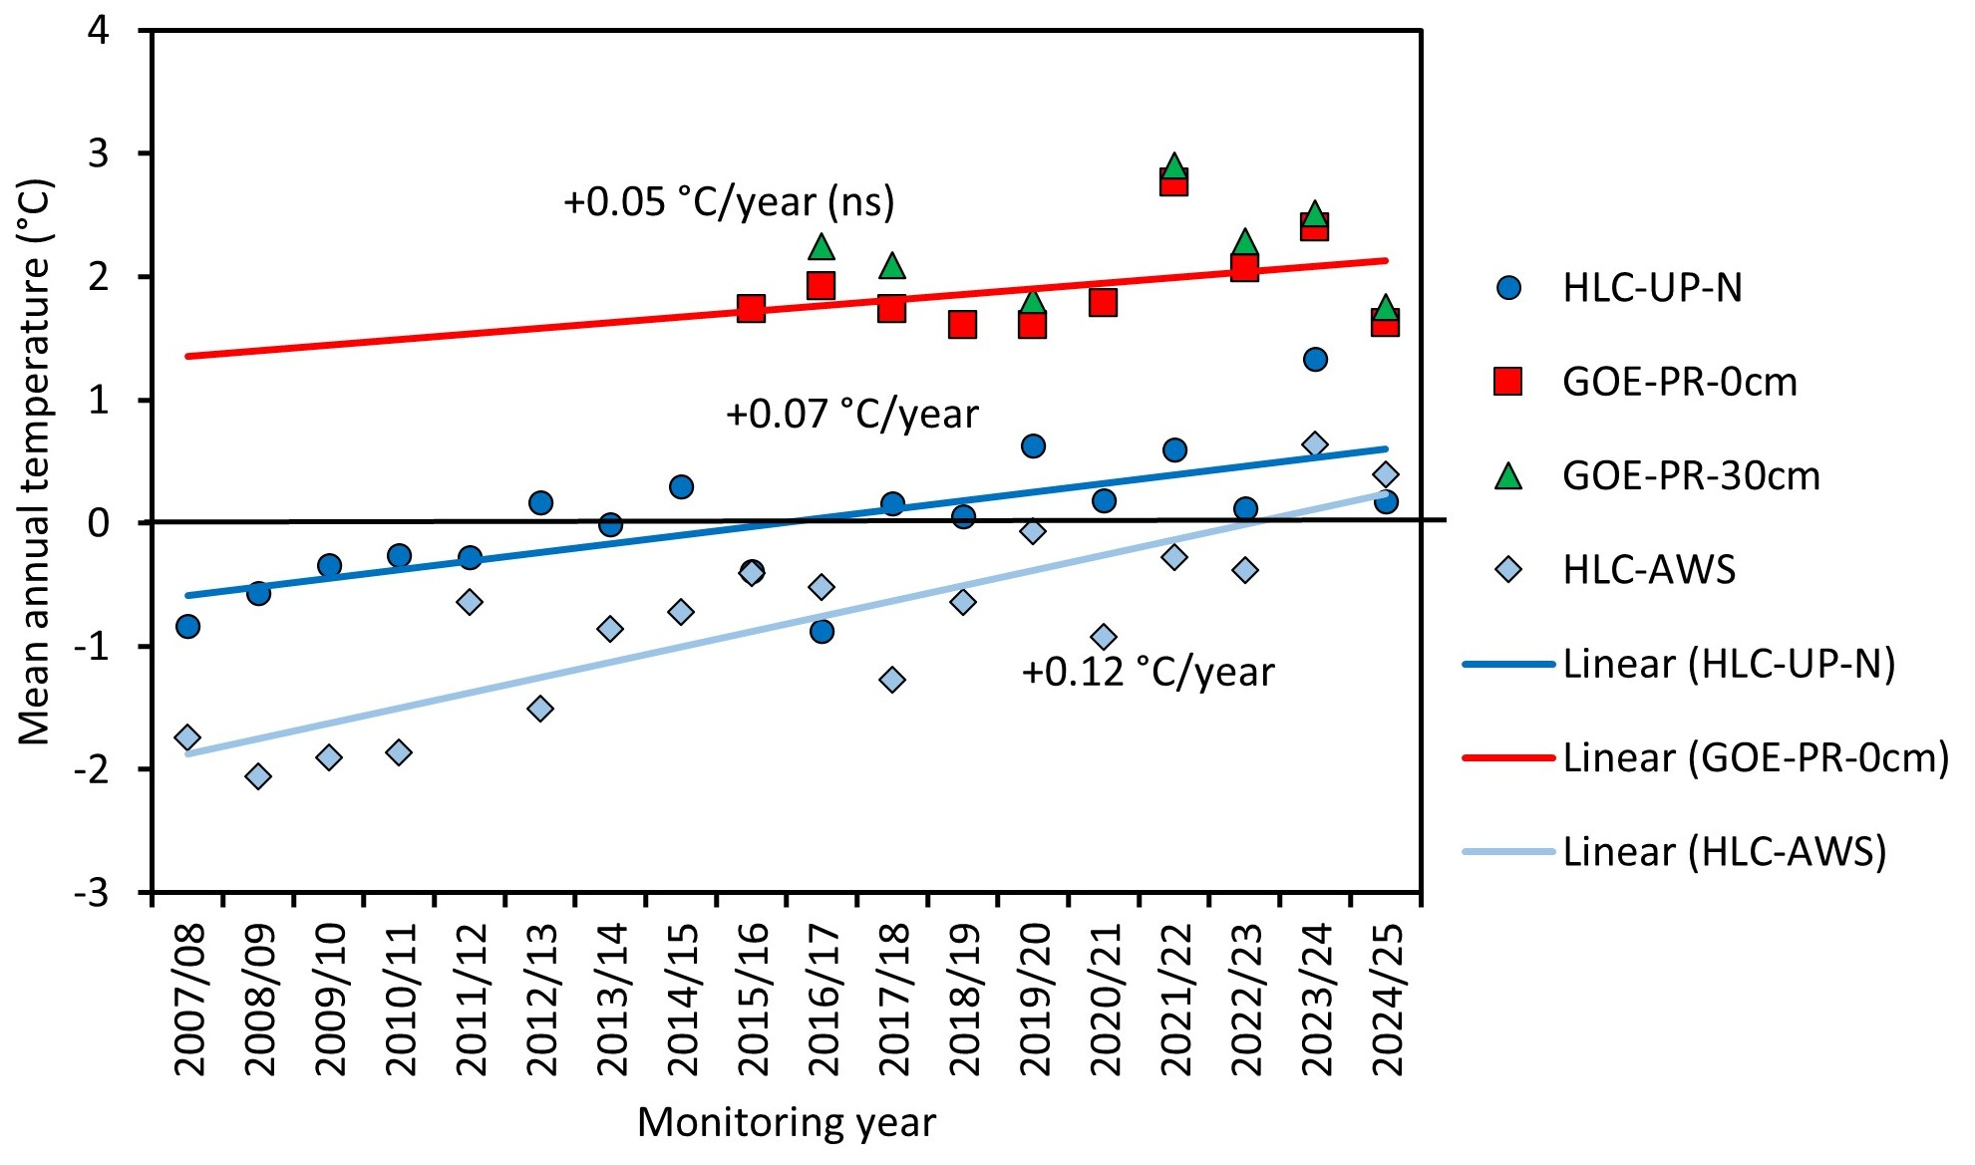
3 Results
3.3 Climatic changes during the study period
Development of the mean annual air and ground temperature
in the area of the Gössnitzkees between 2007 and 2025.

Slide 11
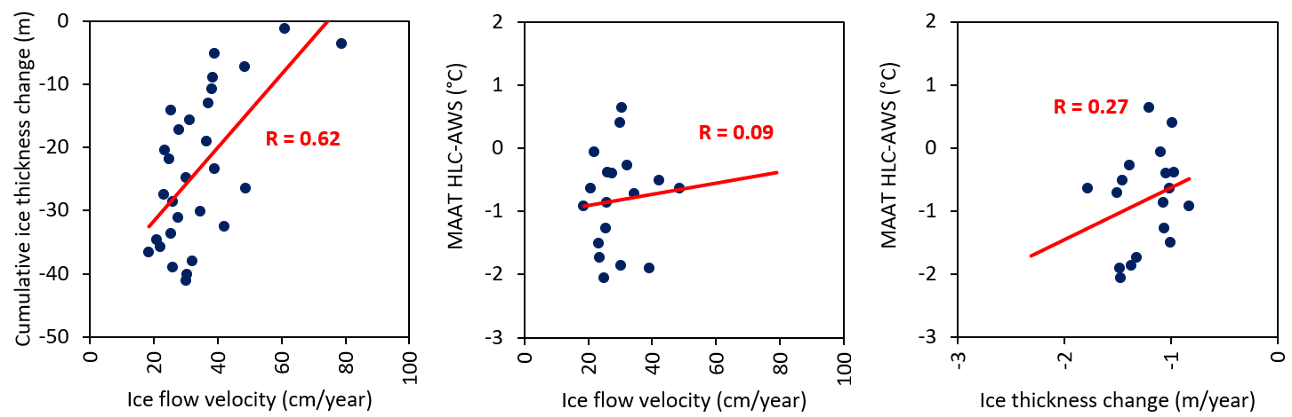
4 Discussion
4.1 Combination of aerial imagery and geodetic data
Deriving glacier margins by calculating the difference between time-disparate digital surface models (DSMs) only works well if the ice thickness change is significantly different from zero. With a negative ice thickness change between two datasets, which is currently the case, only the older of the two glacier extents can be reconstructed.
A further, more recent comparison period is necessary for a reliable determination of the current glacier extent.
Due to the low point density along a profile, geodetic measurements provide only limited information regarding glacier condition. However, these measurements have a higher temporal resolution, complement remote sensing results, and can also be used to verify them.
4.2 Combination of geometric glacier changes with climate data

Slide 12
5 Conclusions
The Gössnitzkees glacier exemplifies how drastically debris-covered glaciers change under sustained climate warming: loss of area, fragmentation into sub-bodies and a significant decrease in ice thickness since the 1990s, accompanied by sharply decreasing flow velocities.
The combination of orthophotos and surface models with annual geodetic measurements provides a robust, complementary picture: remote sensing captures areal changes and velocity fields, while geodesy increases the temporal resolution and validates trends locally.
Climatically, the ground and air temperature series show a significant warming trend.
Nevertheless, the specific ice loss has recently weakened – mainly due to an increasing supraglacial debris layer, which provides increasingly better thermal protection for the ice.
This decouples debris-covered glaciers to a certain extent from short-term air temperature fluctuations; the kinematics are primarily determined by ice thickness and debris cover.
Permafrost can modify cryological processes in the high altitudes of the Schober group, but new formation in the area in front of the Gössnitzkees glacier is currently unlikely considering the ground and air temperature data.
In some regions of the Eastern Alps, the disappearance of freely visible ice is expected soon; however, radiation-protected, debris-covered remnants could persist for decades.

