Slide 1
Secondary metabolites
Secondary metabolites (derived from microorganisms and plants) and synthetic derivatives thereof are among the most widely used therapeutic agents in human and veterinary medicine.
The scope of their medicinally relevant activities is very broad and encompasses: anti-infective therapy (bacteria, fungi, viruses); anti-cancer therapy; immuno-therapy; pain treatment; psycho-pharmacological treatment; and others.
Other areas of application of secondary metabolites are in agriculture where they are used as bio-control agents (e.g. herbicides, insecticides) and plant growth factors.
There is massive interest in the development of new bio-active secondary metabolites, through identification of new target structures as well as through diversification of existing molecular structures. There is also interest in harnessing new heterologous hosts for secondary metabolite production (e.g. use of yeast to produce a plant metabolite such as morphine).

Slide 2
Commerically produced secondary metabolites from plants and their uses.
From Biotechnol. Adv. (2002) 20, 101

Slide 3
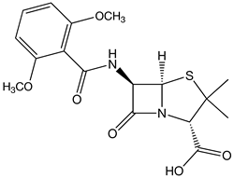
Commerically produced β-lactam antibiotics
The whole market of β-lactam antibiotics was estimated in 2000 to be worth approximately 15 billion US $. The whole market of anti-infective agents (against bacteria) was estimated in 1996 to reach approximately 23 billion US $.
Methicillin
From Appl. Microbiol. Biotechnol. (2003) 61, 385

Slide 4
Penicillin and Cephalosporin producing companies and the world production volumes
Note that 6-APA, 7-ADCA and 7-ACA are produced to prepare semi-synthetic antibiotics, among them ampicillin.
From Appl. Microbiol. Biotechnol. (2003) 61, 385

Slide 5
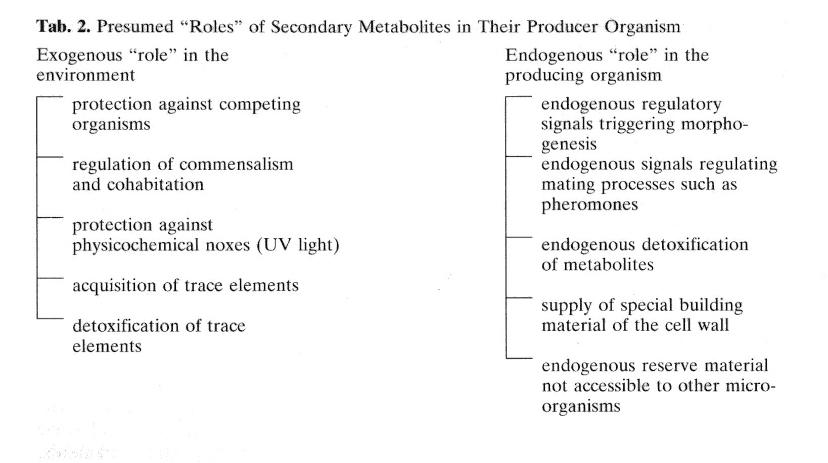
The role of secondary metabolites
Secondary metabolites are not part of the primary metabolism and thus fullfil functions not directly related to vegetative growth, energy production and maintenance.
They are presumed to have multiple other functions in physiology, development and biological ecology.

Slide 6
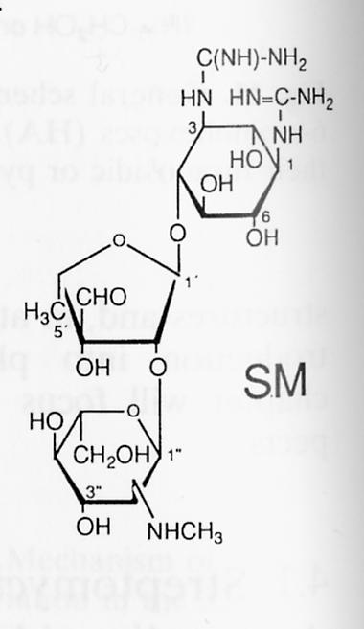
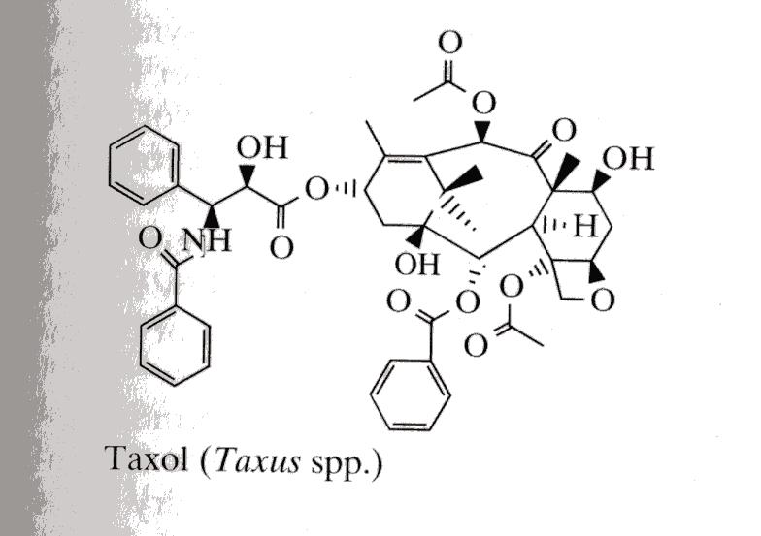
Structural classification of secondary metabolites
Secondary metabolites can be broadly categorized according to chemical structure:
Polyketides (e.g. tetracyclines, macrolides)
Peptides (e.g. β-lactams, cyclosporins)
Glycosides and nucleosides (e.g. Streptomycin)
Terpenoids (e.g. Taxol, morphine)
Streptomycin
Cyclosporin

Slide 7
Secondary metabolite discovery
Gene cluster sequencing and analysis
Verification or identification of gene function
Heterologous pathway expression
Metabolite identification
Screening of biological samples
Taxol was identified at the National Cancer Institutes in the United States out of more than 100,000 examined chemical structures and was approved in 1992 for breast cancer therapy.
Taxol is present in the bark of the yew tree (Taxus brevifolia). A problem was that in order to produce 1 kg of Taxol, 10 tons of dried bark from ≈ 3000 yew trees would have to be processed. About 2 g Taxol were needed per patient and day. Plant cell culture was effective to obtain unlimited amounts of the product.

Slide 8
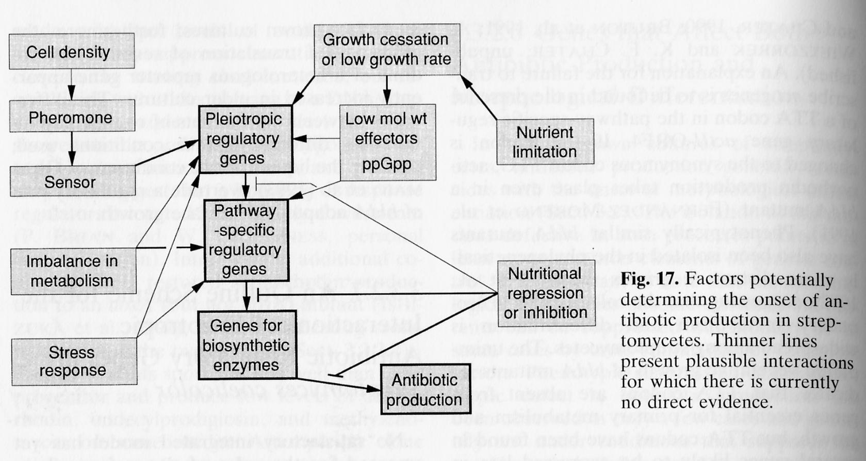
Secondary metabolite production
Biological synthesis of secondary metabolites is usually highly regulated at different levels of cellular regulation.
The „higher level“ regulation involves transcription factors but also small molecules such as guanosine-3’-5’-tetraphosphate (ppGpp).
Morphology (also)
The arrows show where optimization of the process technology is effective to promote the production!

Slide 9
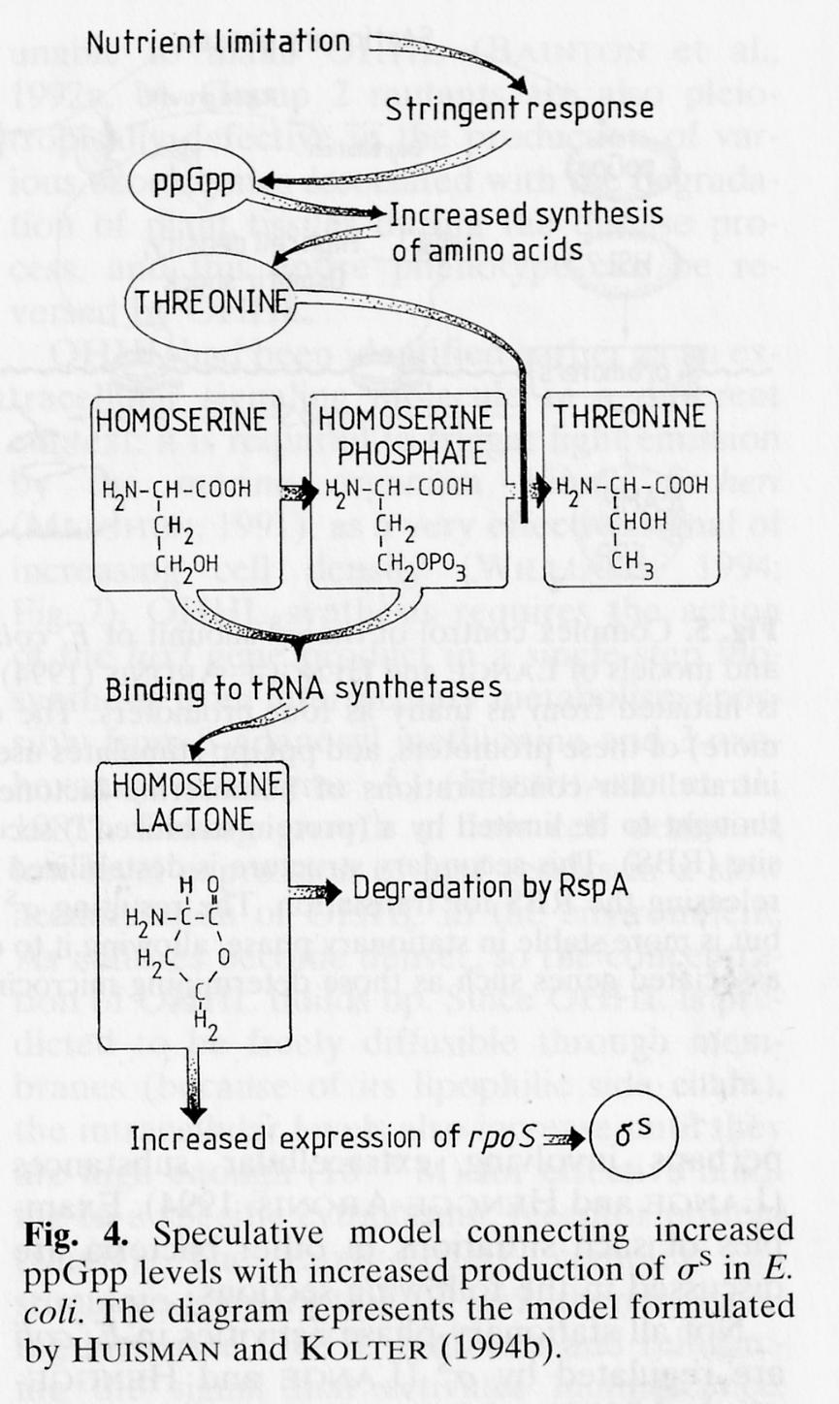
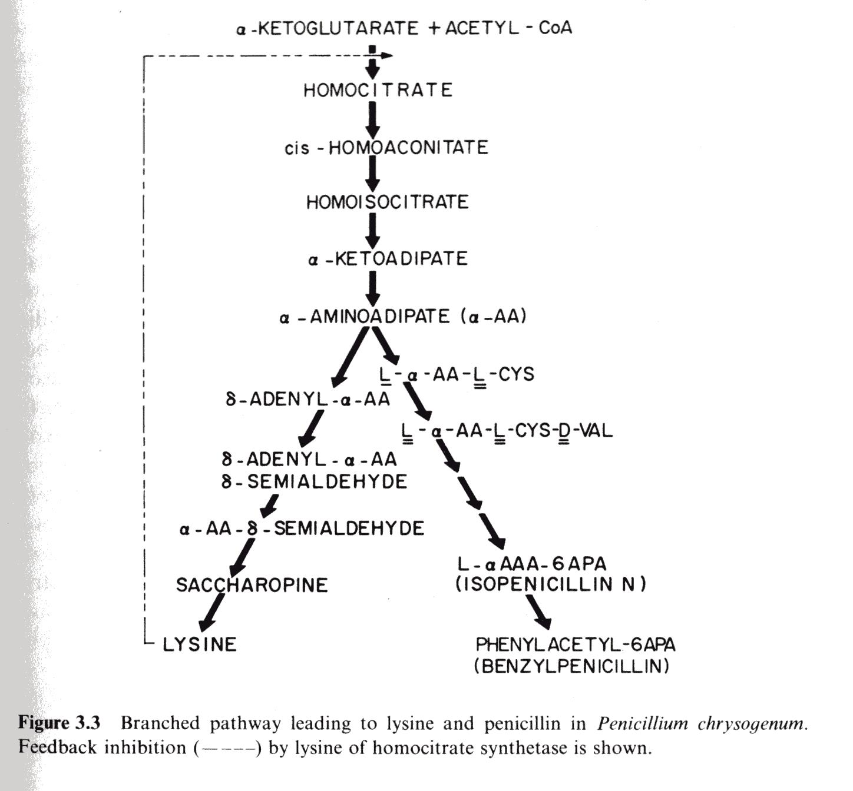
Secondary metabolite production (2)
Pathway specific factors of regulation need to be considered also.

Slide 10
Development of Penicillin production processes
From Appl. Microbiol. Biotechnol. (2003) 61, 385

Slide 11
The morphology of Penicillin producing fungi (Penicillium chrysogenum)
Effect of process conditions on the development of fungal morphology.
Besides (mere) measurement of the biomass concentration, determination and control of morphology is crucial.
Pellet size is also important (see below).

Slide 12
Growth of fungi in pellets
We can approximate the growth as an increase in the pellet radius R.
  dR/dt = k_{g} = const
  where k_{g} is a first-order rate constant (s⁻¹).
Assuming spherical shape, we can write for the biomass M:
M = ρ (4/3) π R³
Therefore,
dM/dt = ρ 4 π R² dR/dt = k_{g} ρ 4 π R²
  dM/dt = γ M ^{2/3} where γ = k_{g} (36 ρ π )^{1/3}
On integration, thus, we obtain for the dependence of M on time t
  M = (M₀^{1/3} + γ t/3)³
In other words, the pellet mass M scales with reaction time to the third (t³).

Slide 13
Biomass filtration (cake filtration, conventional filtration)
Solid particles are separated from a fluid-solid mixture by forcing the fluid through a filter medium or a filter cloth that retains the particles.
Solids are deposited on the filter. The deposit is often referred to as the filter cake.
As the cake increases in depth, a strong resistance to further filtration is created.
A pressure drop across the filter is required, and this can be obtained by positive pressure or by vacuum.
The ease of filtration depends on the properties of the solid and the fluid. Filtration of crystalline, incompressible solids in low-viscosity fluids is simple. However, fermentation broths are often problematic to filter because cells are small and are of gelatineous nature. Cells are ususally strongly compressible. Viscosity is often high and of a Non-Newtonian character.
Compressibility means that the porosity of the cake declines as the pressure drop across the filter increases.
Filtration is usually performed non-sterile.

Slide 14
Use of filter aids in biomass filtration
The most widely used filter aid is diatomaceous earth, also known as kieselguhr. This material has a very high porosity of which, when packed, only around 15% is solid and the rest is empty space. The high porosity facilitates liquid flow around the particles and thus improves the rate of filtration. Kieselguhr particle size is 10 – 25 µm.
Filter aids are used in two different ways. One is to use it as a pre-coat of the filter medium to prevent blockage. The other is to add the filter aid to the fermentation broth, typically at 1 – 5 % loading (by weight), to increase the porosity of the cake as it forms.
Filter aid adds to the cost of the filtration and because it adsorbs liquid it can also result in product losses. Filtrate clarity is typically reduced when filtration rates are increased in the presence of filter aid. Disposal of solid waste is more problematic when it contains filter aid. The use of filter aid is not appropriate when the cells are the actual product of the process or when the cells should be further processed for recovery of intracellular material.

Slide 15
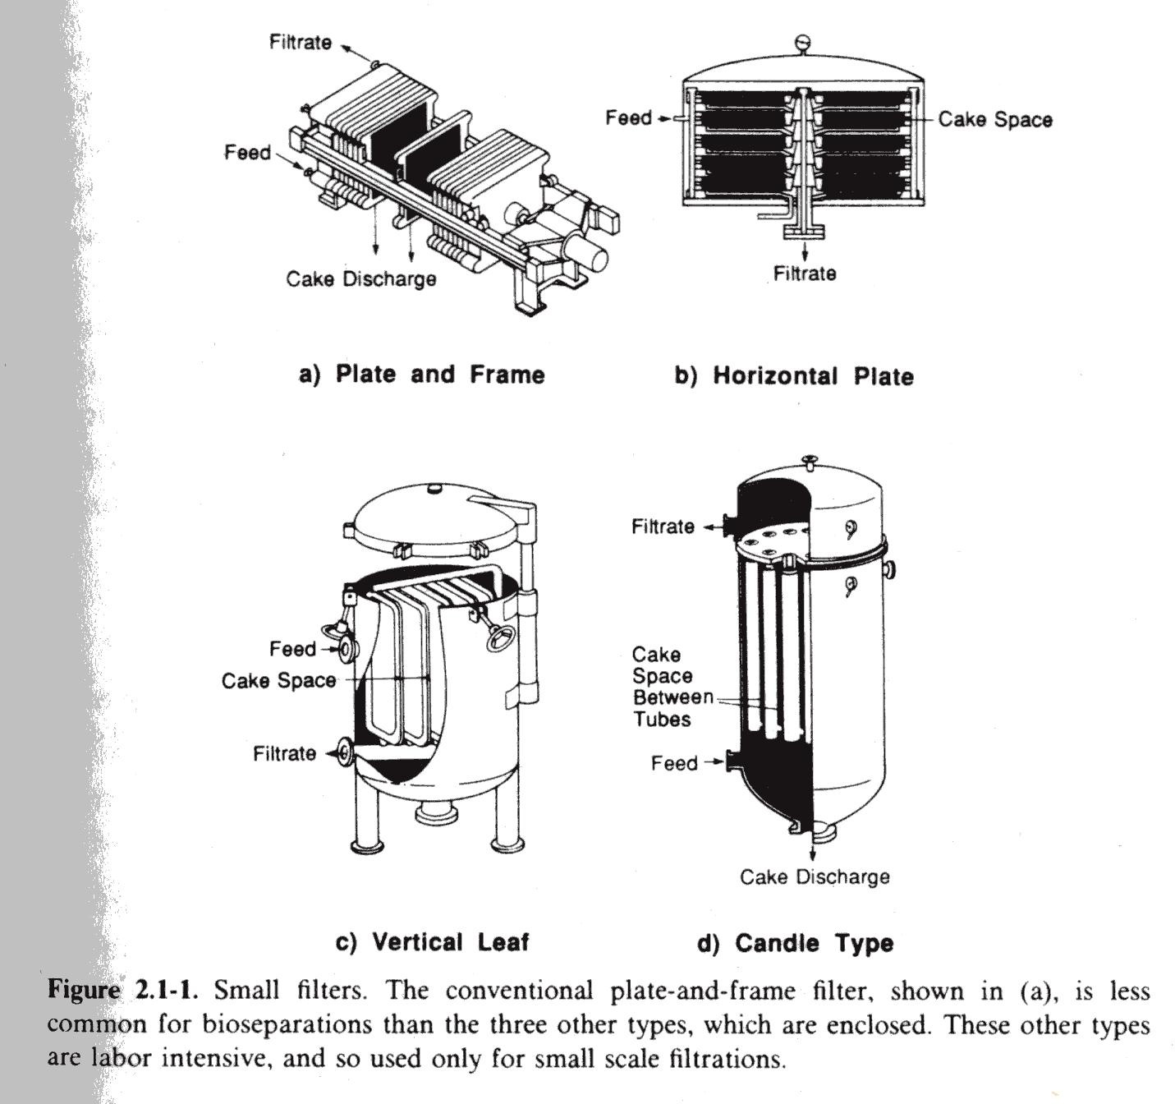
Filtration equipment and apparatus
Plate filters are used for filtration of small fermentation batches. They must be periodically opened and cleared of filter cake.
Rotary drum vacuum filters are widely used. They allow for a fully continuous filtration, as shown below.
Drum diameter:
0.5 – 3 m
Drum rotation:
0.1 – 2 rpm
Rotary drum vacuum filter

Slide 16
Filtration theory and principles
Filtration theory is used to estimate the rate of filtration. For a given pressure drop across the filter, the filtration rate is highest just as the filtering begins. The initial deposition of particles on the filter surface is important because it influences the structure and permeability of the whole filter bed. Excessive pressure used at the very beginning should be avoided.
Flow resistance due to the filter cloth can be considered constant as long as particles do not penetrate the material; the resistance due to the cake increases with cake thickness though.
The filtration rate is given by the relationship, often referred to as Darcy‘s law:
1/A dV_{f}/dt = ΔP/µ_{f} [α(M_{c}/A) + R_{m}] where A is filter area, V_{f} is volume of filtrate, t is filtration time, ΔP is pressure drop, µ_{f} is filtrate viscosity, M_{c} is total mass of solids in the cake, α is the average specific cake resistance, and R_{m} is the filter medium resistance.
The volumetric filtration rate (dV_{f}/dt) is enhanced by an increase in filter area (A). This is however the most expensive item in a filtration.
The parameter α is also crucial. It is related to compressibility.

Slide 17
Filtration theory and principles (2)
For a compressible filter cake, we can use:
α = α* ΔP^{s} where s is the cake compressibility and α* is a constant largely dependent on the size and morphology of the particles in the cake.
The value of s is zero for rigid and incompressible solids; for highly compressible materials s is close to unity. As the value of s increases, α increases with increasing pressure drop and so the filtration rate declines.
α is also related to the average properties of the particles.
α = K_{v} a² (1 – ε)/ε² ρ_{P} where K_{v} is a factor dependent on the shape of the particles, a is the particle specific surface area, ρ_{P} is particle density, and ε is the porosity of the cake
The rate of filtration can be improved by:
Increase in filter area A
Increase in pressure drop ΔP
Reduction of the cake mass M_{c}
Reduction of the liquid viscosity µ_{f}
Reduction of specific cake resistance α, via shape factor change (e.g. in mycelial broths) and reduction of the specific surface area a

Slide 18
Filtration theory and principles (3)
Note: M_{c} = c V_{f} where c is the mass of solid deposited per volume of filtrate
For integration it is convenient to write Darcy‘s law in a reciprocal form.
A dt/dV_{f} = µ_{f} α c V_{f}/A ΔP + µ_{f} R_{m}/ΔP
By separating the variables and placing constant terms outside of the integrals, we obtain for the initial condition t = 0 and V_{f} = 0:
A t = [µ_{f} α c V_{f}²/2 A ΔP] + [µ_{f} R_{m} V_{f}/ΔP]
Provided all other parameters are known, one can calculate for a constant-pressure filtration the filtrate volume or the time. However, α and R_{m} typically need to be determined beforehand.
Dividing the equation above by AV_{f} and with rearrangement we get:
t/V_{f} = [µ_{f} α c V_{f}/2 A² ΔP] + [µ_{f} R_{m}/A ΔP] which can be written more simply
t/V_{f} = K₁ V_{f} + K₂ with:
K₁ = µ_{f} α c /2 A² ΔP and K₂ = µ_{f} R_{m}/A ΔP
For a constant-pressure filtration, K₁ and K₂ are constant. Plotting t/V_{f} against V_{f} gives a straight line. The slope K₁ depends on the pressure drop and on the cake properties. The intercept K₂ depends on pressure drop but is independent of the properties of the cake. α is determined from the slope, R_{m} from the intercept. The analysis is applicable also to compressible filter cakes although K₁ becomes more complex in that case.

Slide 19
Precipitation
It is a widely used method applied (at an early stage) to the recovery of proteins but also that of small molecules (e.g. citric acid, antibiotics).
Precipitation is triggered normally through the addition of a precipitant (e.g. salt, solvent, polymer) or a change in one or more of the bulk parameters pH, ionic strength and temperature. The solubility of the product (or of contaminants) is thus reduced and the solid precipitate is recovered by (micro)filtration or centrifugation.
A main advantage of precipitation is often the volume reduction achieved.
In proteins, precipitation is governed by the protein‘s surface properties (see panel a below) and the properties of the solvent.
The Stern layer is a close layer of counter-ions at the protein‘s surface.

Slide 20
Methods of precipitation
Salting out, promotes aggregation of proteins at high salt concentrations due to disruption of the hydration barriers between individual protein molecules. The Cohn equation describes the solubility S at ionic strength I. β and K are constants.
  logS = β – K I
  I = ½ Σ z_{i}²C_{i} where z_{i} is ionic charge and C_{i} is the concentration of ion i.
  If there is only a single ion that is used to change the ionic strength:
  logS = β_{S} – K_{S} C_{S}
In the precipitation of a pure protein by a single salt, K_{S} depends on the properties of the protein and the salt but is rather insensitive to pH and T. By contrast, β_{S} varies strongly with pH, T, and protein nature but is largely independent of the salt used.
The Hofmeister series gives the relative effectiveness of anions for protein precipitation. The higher K_{S} the more effective the anion is.
citrate>phosphate>sulphate>acetate>chloride>
nitrate>thiocyanate.
aldolase precipitation: open circles, pure protein; full circles: mixture with other proteins

Slide 21
Methods of precipitation (2)
Because polyvalent cations (e.g. calcium, magnesium) tend to decrease K_{s}, sodium is mostly used. The heat of solution of the salt should be low and the salt should be inexpensive. Therefore, (NH₄)₂SO₄ is widely used. Its disadvantages are corrosiveness, release of ammonia at high pH and the possibility of toxic reactions in animals. Salting-out precipitation requires that the salt is removed at some point later in the DSP, by dialysis, diafiltration or gel chromatography for example. This can create substantial extra costs and also large dilution effects.
Isoelectric precipitation, involves precipitation under conditions in which the protein has (a near) zero net charge. The advantage is that removal of salt is not necessary.
Precipitation with organic solvents, using solvents having a lower dielectric constant than water
Precipitation with organic polymers
Selective (affinity-like) precipitation

Slide 22
Process technology of precipitation
Precipitate properties, especially particle size and size distribution are important for recovery. Particles with a size of just 1 µm or less are usually considered unsuitable for further processing. Strongly hydrated protein precipitates have a density hardly different from that of the bulk liquid. Furthermore, protein precipitates are often colloidal or gelatineous in nature which creates difficulties in handling.
Precipitation is usually performed in batch. Precipitant is added to the protein solution and mixed in by stirring. Precipitate formation goes through different steps including nucleation, particle growth and aging, sometimes also called ripening. Mixing is important at each step.
The particle size increases from nucleation to aging.
Precipitation of casein by salting out with (NH₄)₂SO₄ and aging without stirring (left panel) and effect of stirring on particle size during aging (right panel).

Slide 23
Crystallisation
It is used for product polishing or final purification of a wide range of fermentation products. Many pharmaceuticals and fine biochemicals are marketed in the form of crystals.
The formation of solids from solution is a feature common to precipitation and crystallisation. The main difference, however, is that crystals contrary to precipitates often achieve a high degree of purity of 99% or greater.
The degree of purification achieved by crystallisation is often so high that other unit operations of downstream processing, such as chromatography, are no longer required.
Crystallisation results in a two-phase slurry, sometimes referred to as magma, that contains mother liquor and solid crystals.
Crystals are recovered by solid-liquid separation techniques and are usually washed and dried prior to packaging.
Industrial crystallisation is a complex process. It involves two phases and multiple components. It is a surface-dependent process in which simultaneous heat and mass transfer has to take place. It is sensitive to hydrodynamics, particle mechanics, vessel geometry and mode of operation. It is sometimes said that crystallisation still is an art (rather than a science).

Slide 24
Crystal properties
The properties of a crystal are characterized in terms of shape, size, size distribution and purity.
Crystals are composed of molecules, atoms or ions arranged in an orderly, repetitive three-dimensional array (space lattice). Under ideal growth conditions, reproducible and well-defined crystal shapes are obtained. What may change, however, in response to external factors is the crystal habit. It may be necessary to produce a certain substance with a definite crystal habit. Various properties of the solid material are affected by the crystal habit.
Different crystal habits for hexagonal crystals.

Slide 25
Crystal shape and size, and size distribution
Invariant crystals are those whose habit and geometric properties are constant during growth. The size of the crystal is expressed using a single dimension known as the characteristic length L. The value of L is measured by sieving analysis and the individual properties of the crystal are related to L together with appropriate shape factors for area (k_{a}), volume (k_{v}) and mass (ρk_{v}).
Surface area A_{C} = k_{a}L²
Volume V_{C} = k_{v}L³
Mass M_{C} = ρV_{C} = ρk_{v}L³
The shape and size of crystals are negatively affected by agglomeration of individual crystals to larger particles. Furthermore, polymorphism, arising due to multiple crystal forms, can interfere with the production of well-defined crystals.
Crystallisation can produce crystals with a range of sizes. Sieving or screening is the simplest method of determining the resulting crystal size distribution. The mass fraction (Δw) retained at a particular screen is determined as Δw = ΔM/M_{T} where ΔM is mass retained and M_{T} is total mass.
The mass density distribution (m) is given as: m = Δw/ΔL.

Slide 26
Crystal size distribution, and purity
Size distribution can be based on mass but they are often also given in terms of number. The number can be calculated from an average value value of L (L_{av}):
ΔN = ΔM/ρk_{v}L_{av}³
The crystal number density or crystal population density n is given by:
n = ΔN/ΔL
n has the dimension of a reciprocal length, typically 1/mm.
Impurities in crystals are typically carried over from the mother liquor, via adsorption, entrapment, inclusion or substitution within the crystal lattice.
L_{D}, dominant size

Slide 27
Crystal formation and growth
The critical phenomena in crystallisation are the formation of new crystals and crystal growth. The driving force in both processes is the degree of solute supersaturation in the solution.
The solubility of a substance in a particular solvent is the maximum concentration that can be dissolved under given conditions of temperature and pressure while maintaining thermodynamic stability (e.g. no precipitation occurs). The solution is referred to as saturated.
By contrast, supersaturated solutions are thermodynamically unstable. It is however possible that a supersaturated solution is metastable which means that it resists certain (small) changes in conditions (e.g. temperature) but becomes unstable when subjected to larger perturbations. Because in practice we do not deal with ideal and pure solutions, solubility curves must usually be determined experimentally.
The solubility curve represents the condition of thermodynamic equilibrium between the liquid and the solid phases.
Supersaturation driving force: ΔC = C – C*
Supersaturation ratio: S = C/C*
Relative supersaturation: σ = (C – C*)/C* = ΔC/C* = S - 1

Slide 28
Crystal formation and growth (2)
Spontaneous crystallisation occurs only in the labile region. Crystal growth can also take place in the metastable region.
Besides decreasing temperature, supersaturation can be achieved by a combination of cooling and evaporation. It can also be achieved by adding a substance that reduces the solubility of the solute. This is often referred to collectively as salting-out, even though the added substance is water-miscible organic solvent.
Crystallisation involves nucleation and crystal growth.
There is primary nucleation, which can be homogeneous (i.e. spontaneous from solution) or heterogeneous (i.e. induced by foreign particles). Secondary nucleation is the generation of new crystals by crystals already present.
Figure CG

Slide 29
Crystal formation and growth (3)
Secondary crystallisation involves various (possible) factors, including dislodgment of small crystals from the surface of larger ones, contact due to collisions between crystals or crystals and the vessel walls and impeller, and crystal breakage. Contact or collision nucleation (or collision breeding) is thought to be the most relevant mechanism. It is effective when the concentration of the suspended crystals and the agitation rate are both high.
Secondary crystallisation occurs at a much lower supersaturation than primary crystallisation. To minimize the range of crystal sizes produced, it is desirable to avoid excessive generation of new crystals. Conditions are therefore usually confined to the metastable region. In other words, secondary nucleation is made to dominate the overall crystallisation process.
The birth rate B of new crystals can be described:
B = K_{N} (C – C*)^{b} where K_{N} is a nucleation rate constant and b is a constant
The parameters K_{N} and b depend on the system properties (e.g. temperature, agitation rate, impurities, concentration of the crystals under conditions where secondary nucleation dominates).

Slide 30
Crystal growth (4)
This refers to the increase in crystal size due to deposition of solute molecules in layers on the crystal surface (see the Figure CG before).
Mathematically, the linear growth rate G (LT⁻¹; µm h⁻¹) becomes:
G = dL/dt
Alternatively, crystal growth can be expressed in terms of the mass deposition rate or mass growth rate, R_{G} (MT⁻¹; kg s⁻¹)
R_{G} = dM_{C}/dt = 3ρk_{v}L²dL/dt = 3ρk_{v}L²G
Also, because L² = A_{C}/k_{a} we have:
R_{G} = 3ρk_{v}A_{C}G
For geometrically similar crystals of the same material grown from birth in the same solution, the rate of growth of all crystals is the same irrespective of their size. This is known as the ΔL law which was shown to hold for many industrial crystallisations.
However, there is also deviation from ΔL law which results in a size-dependent crystal growth.
The diffusion-integration model considers crystallisation as a two-step process where mass transfer of solute to the crystal surface is followed by surface reaction to integrate the from solution. Thus,
R_{G} = K_{GM}A_{C}(C – C*)^{g} where K_{GM} is an overall growth coefficient and g is the growth order. K_{GM} depends on system properties (temperature, agitation, ...).

Slide 31
Practical crystallisation
For crystallisation in practice it is important to control the relative rates of nucleation and crystal growth. Seed crystals are often used to initiate the crystallisation operated in the metastable region.
Crystallisation apparatus involves the cooling crystallizer, the evaporative crystallizer and the vacuum crystallizer. Note that encrustation can be a problem in particular with cooling crystallisation.
Continuous crystallisation operations include the mixed suspension – mixed product removal (MSMPR; a), MSMPR with liquid overflow (b), mixed suspension with liquor recycle and classified product removal (c), and mixed suspension with liquor overflow, partial liquor recycle and classified product removal.

Slide 32
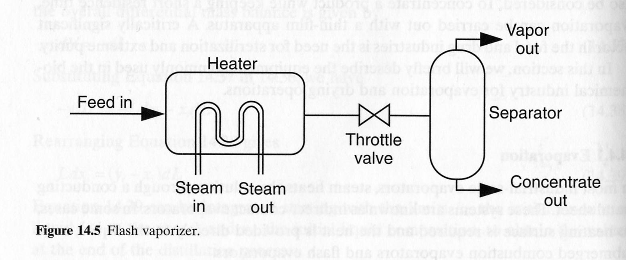
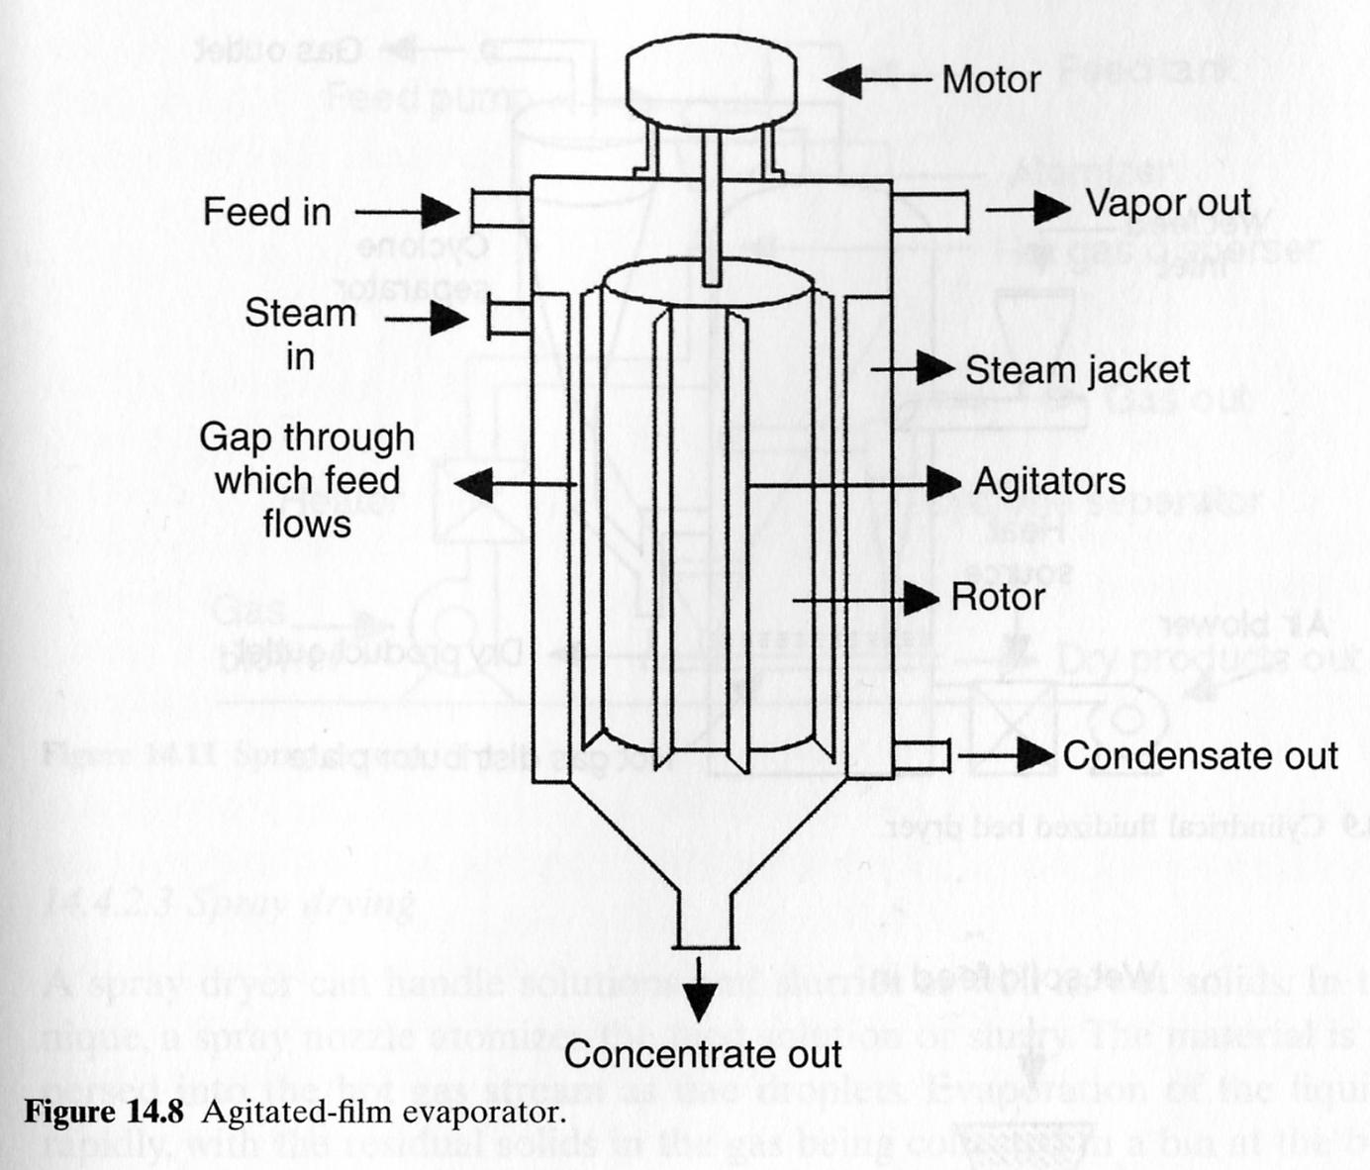
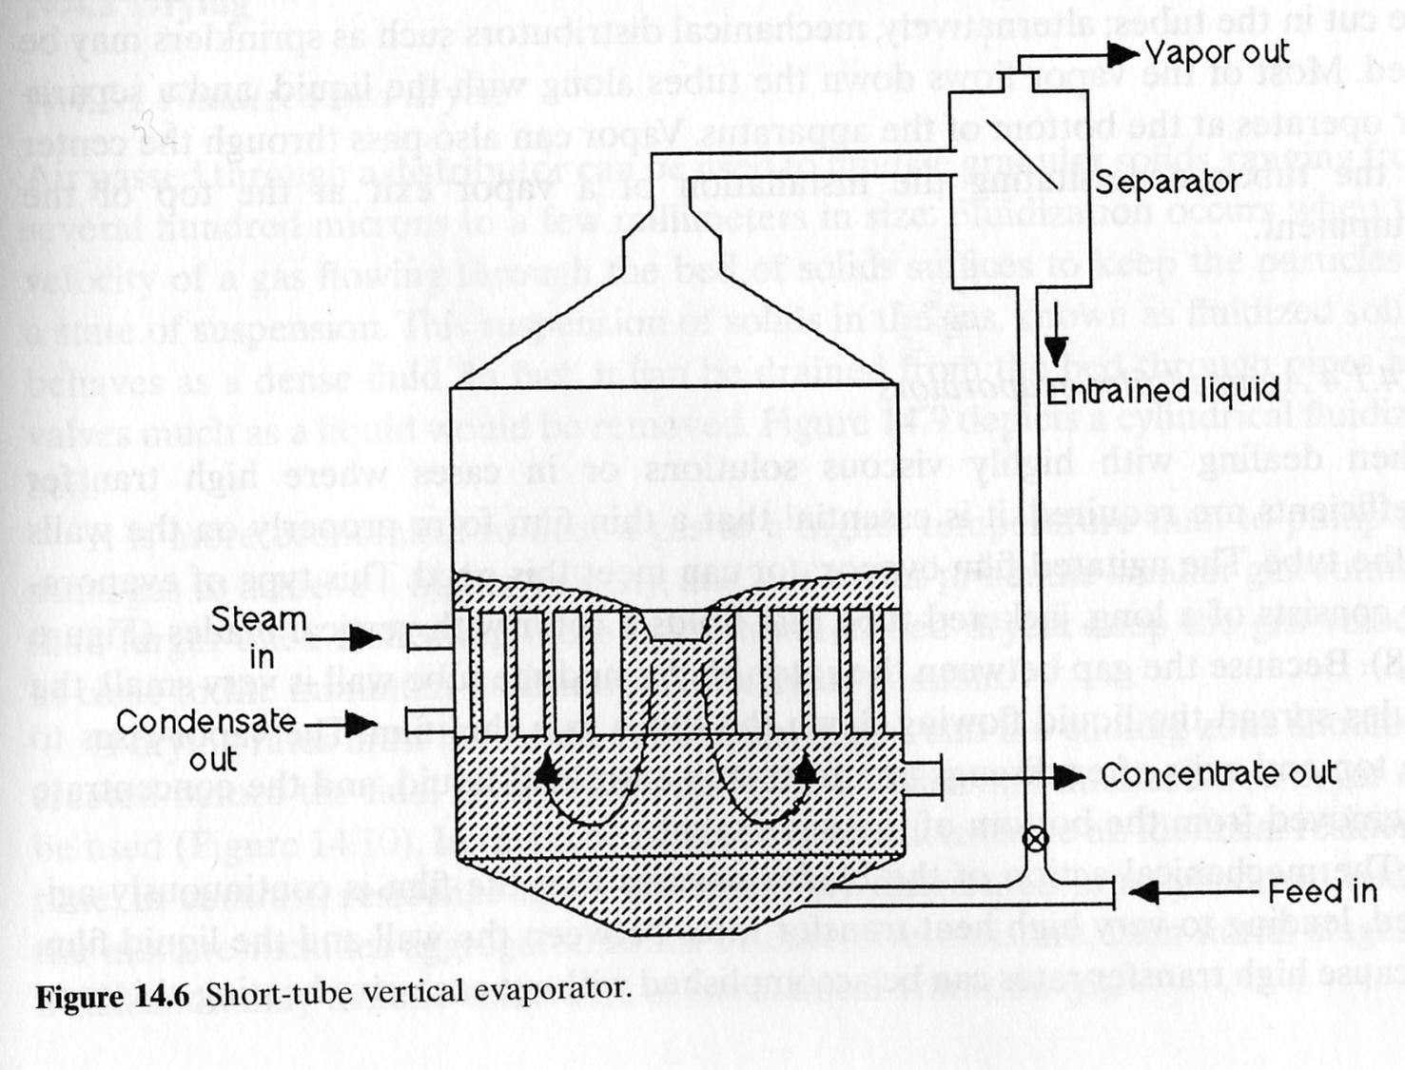
Concentrating solutions
Besides membrane filtration (see the Ethanol part of the lecture), evaporative concentration is useful.
Widely used apparatus include: the flash vaporizer; different types of evaporator (e.g. short-tube or film evaporator)

Slide 33
Drying
It is often the last step in the DSP for recovery of solid products. The aim is to remove relatively small amounts of of residual water or solvent from materials. It may be necessary to minimize degradation.
Drying is usually achieved by vaporizing the solvent (e.g. liquid water or ice) and removing the vapor.
The equilibrium moisture content of a solid as a function of the air relative humidity (P_{w}/P_{wS} × 100%) is called the equilibrium water sorption isotherm. P_{w} is the water vapour pressure in air and P_{wS} is the saturation vapour pressure of pure water.
S. cerevisiae (full circles)
cryst. insulin (open squares)
cryst. lysozyme (full triangles)
sodium benzyl penicillin
(open circles)
A hysteresis results when desorption and adsorption isotherms do not coincide.
A typical drying curve is shown.

Slide 34
Drying kinetics
The drying rate N is defined as:
N = - M_{S} dX/dt where M_{S} is the mass of the completely dry solid and X is the moisture content of the solid on a dry mass basis.
The drying rate can also be expressed based on unit area A so that it becomes a flux n_{a}:
n_{a} = - M_{S}/A dX/dt
Alternatively, the drying rate per unit mass of dry solid, n_{m}:
n_{m} = - dX/dt
The rate of heat transfer Q during drying becomes (analogous to Bioprocess Technology I):
Q = UA_{h}(T_{a} – T) where U is the overall heat transfer coefficient, A_{h} is area available for heat transfer and T_{a} is the air temperature.
U will normally equal the heat transfer coefficient for the fluid boundary layer on the solid surface (h_{S}). If the rate of drying derives solely from the evaporation of water, we get the rate of water vapour production by relating Q to the latent heat of vaporisation (Δh_{v}).
Rate of water vapour production = h_{S}A_{h}(T_{a} – T)/Δh_{v}.
The rate of water mass transfer from solid to vapor phase (N_{A}) is:
N_{A} = k_{G}a(Y – Y_{a}) where Y is the humidity of air in equilibrium with water at the surface temperature used, Y_{a} is the actual humidity of air, a is the surface area available for mass transfer and k_{G} is a mass transfer coefficient.

Slide 35
Drying kinetics (2)
At steady state, therefore, the constant drying rate N_{C} becomes:
N_{C} = h_{S}A_{h}(T_{a} – T)/Δh_{v} = k_{G}a(Y – Y_{a})
To apply this equation, the heat and/or mass transfer coefficients must be determined for the particular drying equipment and operating conditions used. Calculation of N_{C} is usually based on the heat transfer component of the equation. Application of the mass transfer equation is not as straightforward: the distribution of moisture in the solid material changes during drying, so there is considerable uncertainty about the driving force, (Y – Y_{a}), of the mass transfer.
The drying time is calculated from:
N_{C} = - M_{S} dX/dt and thus, after integration:
Δt = M_{S}/N_{C} (X₀ – X₁)
If the drying rate is not anymore constant (see the figure showing the drying curve), alternative models need to be used.

Slide 36
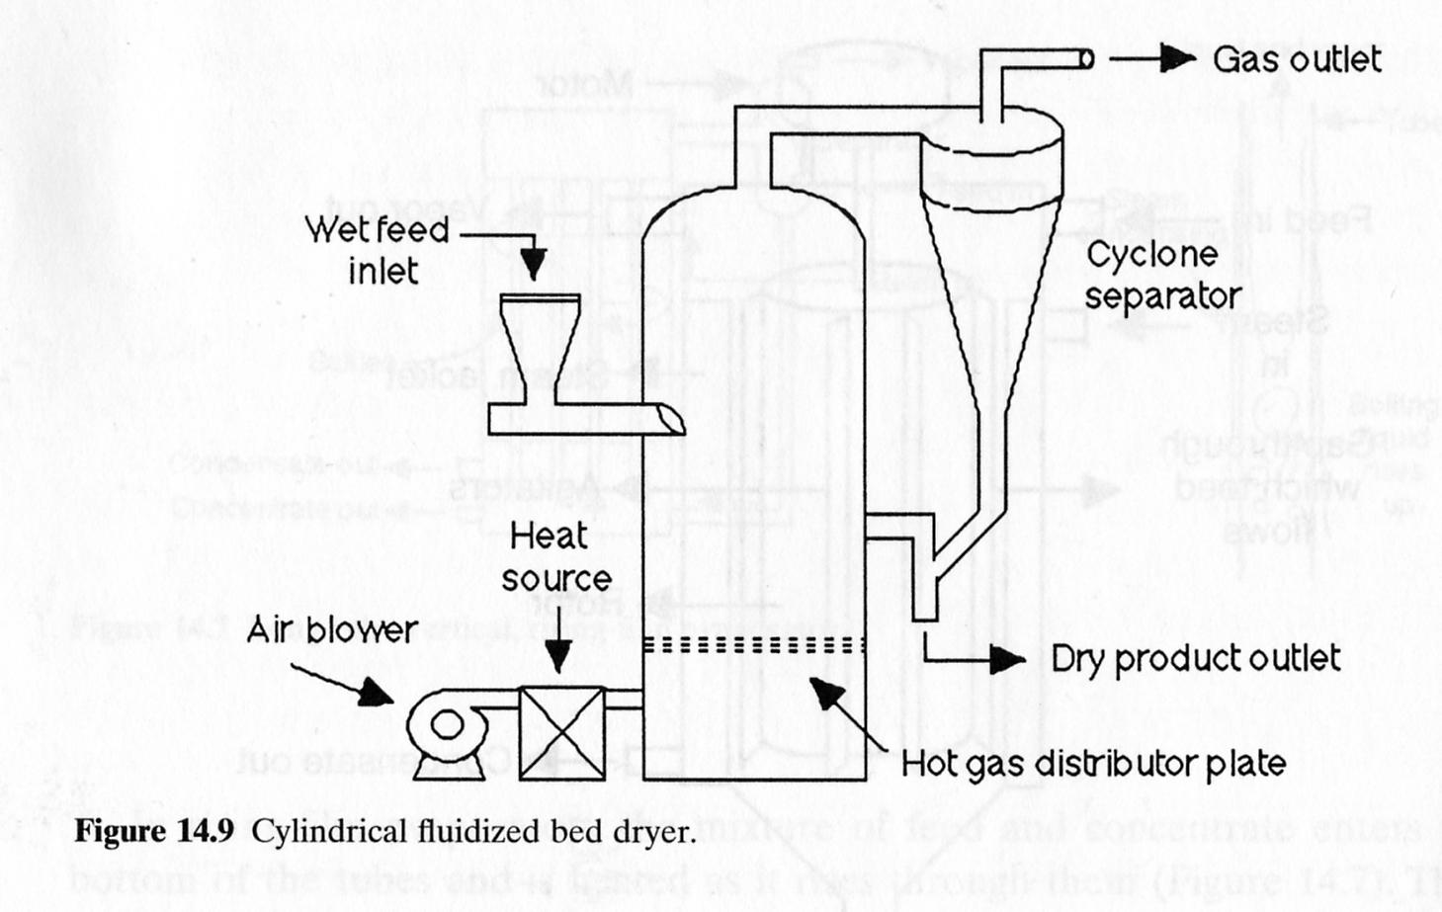
Drying apparatus
Equipment for drying differs in principle in the way the wet solid is brought into contact with the hot air or medium in general.
We have direct contacting, as in spray driers, but also indirect heating. Combinations of the two modes can also be used.
For labile products, the contact time in spray driers is kep low (0.5 to approximately 6 seconds).

Slide 37
Freeze drying
This is also called lyophilisation or cryodesiccation. It is used to dry unstable and heat-sensitive products which are thus protected from damage and decomposition.
The process involves placement of wet solids in a (partially) open vial or vessel so that water vapour can escape. The material is frozen and exposed to low pressure. Because operation is done below the triple point in the water phase diagram, the frozen water within the solid therefore sublimates directly to vapor, i.e., without passing through a liquid phase. Sublimation of ice crystals leaves back a porous solid structure.
Freeze drying is a process mainly used in the pharmaceutical industry and applied to proteins in particular. The energy required for freeze drying is substantially larger than for other drying methods. The time required is generally also longer. This increases proportional to material thickness to the power of 1.5 – 2.0.
Freeze drying typically involves three steps:
1) Freezing; 2) Sublimation or primary drying; 3) Desorption or secondary drying.

Slide 38
Freeze drying (2)
The time profiles for operating variables in freeze drying are shown below (left figure). Freezing occurs at roughly atmospheric pressure and takes the temperature to -40 to -80°C. When the temperature is low enough so that liquid water does not form on reduction of pressure, primary drying is initiated by decreasing the chamber pressure. Ice is removed by sublimation. After that, the temperature of the material increases and secondary drying begins. Unfrozen water is removed in that phase.
A typical freezing curve for an ideal two-component mixture (e.g. water and solute) is shown in the right figure. At point b, supercooling is observed and nucleation of ice crystals is induced. The resulting increase in temperature is the latent heat of fusion. Cooling to point c promotes the ice crystals to grow in size. The solute concentration in the liquid increases accordingly until it reaches saturation and therefore begins to crystallize. A eutectic point T_{e} may be reached, meaning that water and solute solidify as if they were a single compound. T_{e} is the maximum point allowed during primary drying.
Typically, 24 – 48 h

Slide 39
Freeze drying (3)
Note that not all aqueous solutions exhibit eutectic behavior and some solutes do not crystallize during freezing. In amorphous (non-crystalline) systems, after the ice begins to form and the solution gets more and more concentrated, the solution viscosity increases so that the material becomes syrupy and then rubbery. On further reduction in temperature, a glass transition occurs at temperature T_{g} as the solution changes from a viscous to a glass-like material.
The T_{g} is the maximum temperature suitable for primary drying of noncrystalline systems because above T_{g} liquid is present. If the temperature exceeds T_{e} or T_{g} during primary drying, the solid may collapse and so the microstructure of the crystalline or amorphous product may be destroyed.
Primary drying typically removes about 95% of the water contained in the solid. Heat transfer is often the rate-limiting step in this step.
Secondary drying is most important for amorphous materials which retain a substantial amount of water during sublimation in primary drying.

